Slide 2
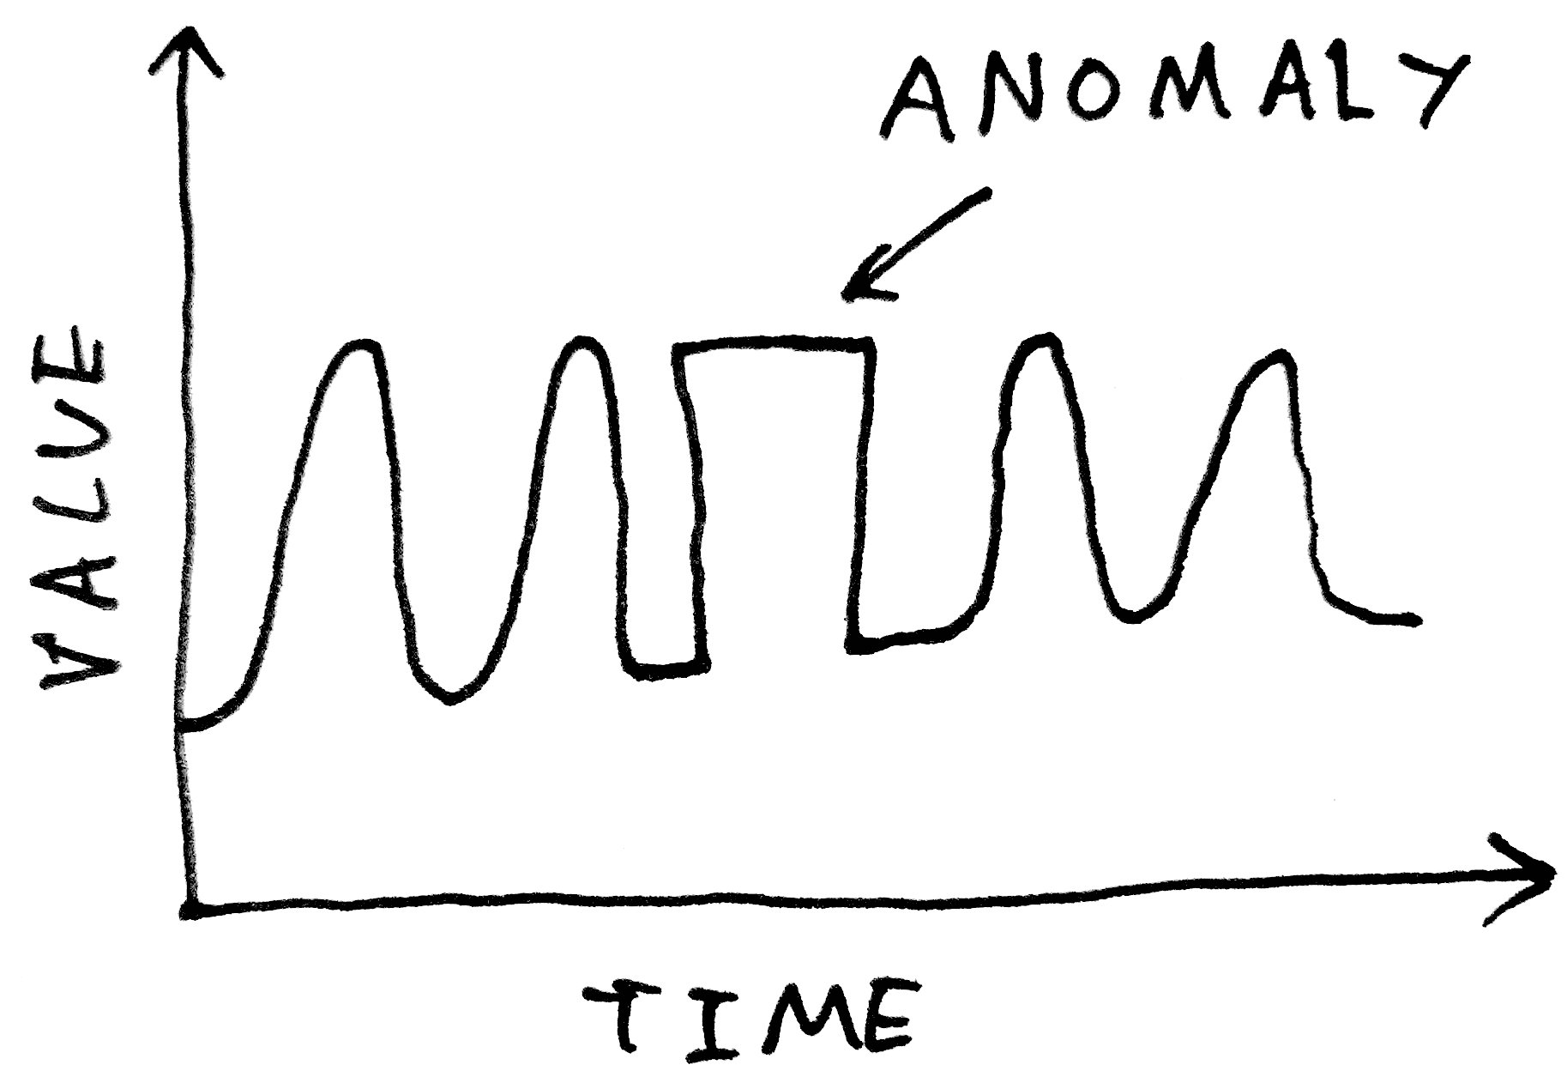
An introduction to Outlier Detection: Part II
Runar Helin
http://amid.fish/anomaly-detection-with-k-means-clustering

Slide 3
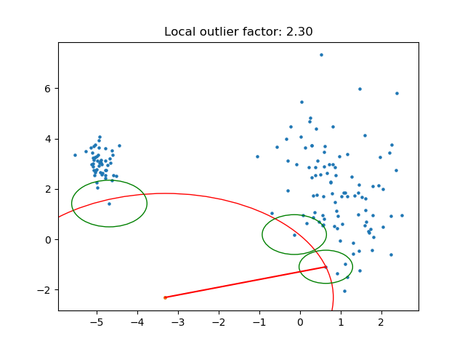
Local outlier factor

Slide 4
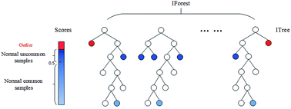
Isolation forest

Slide 5
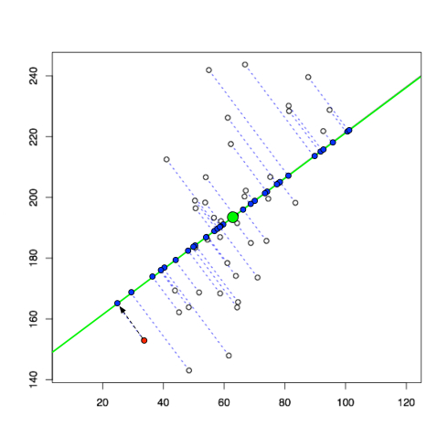
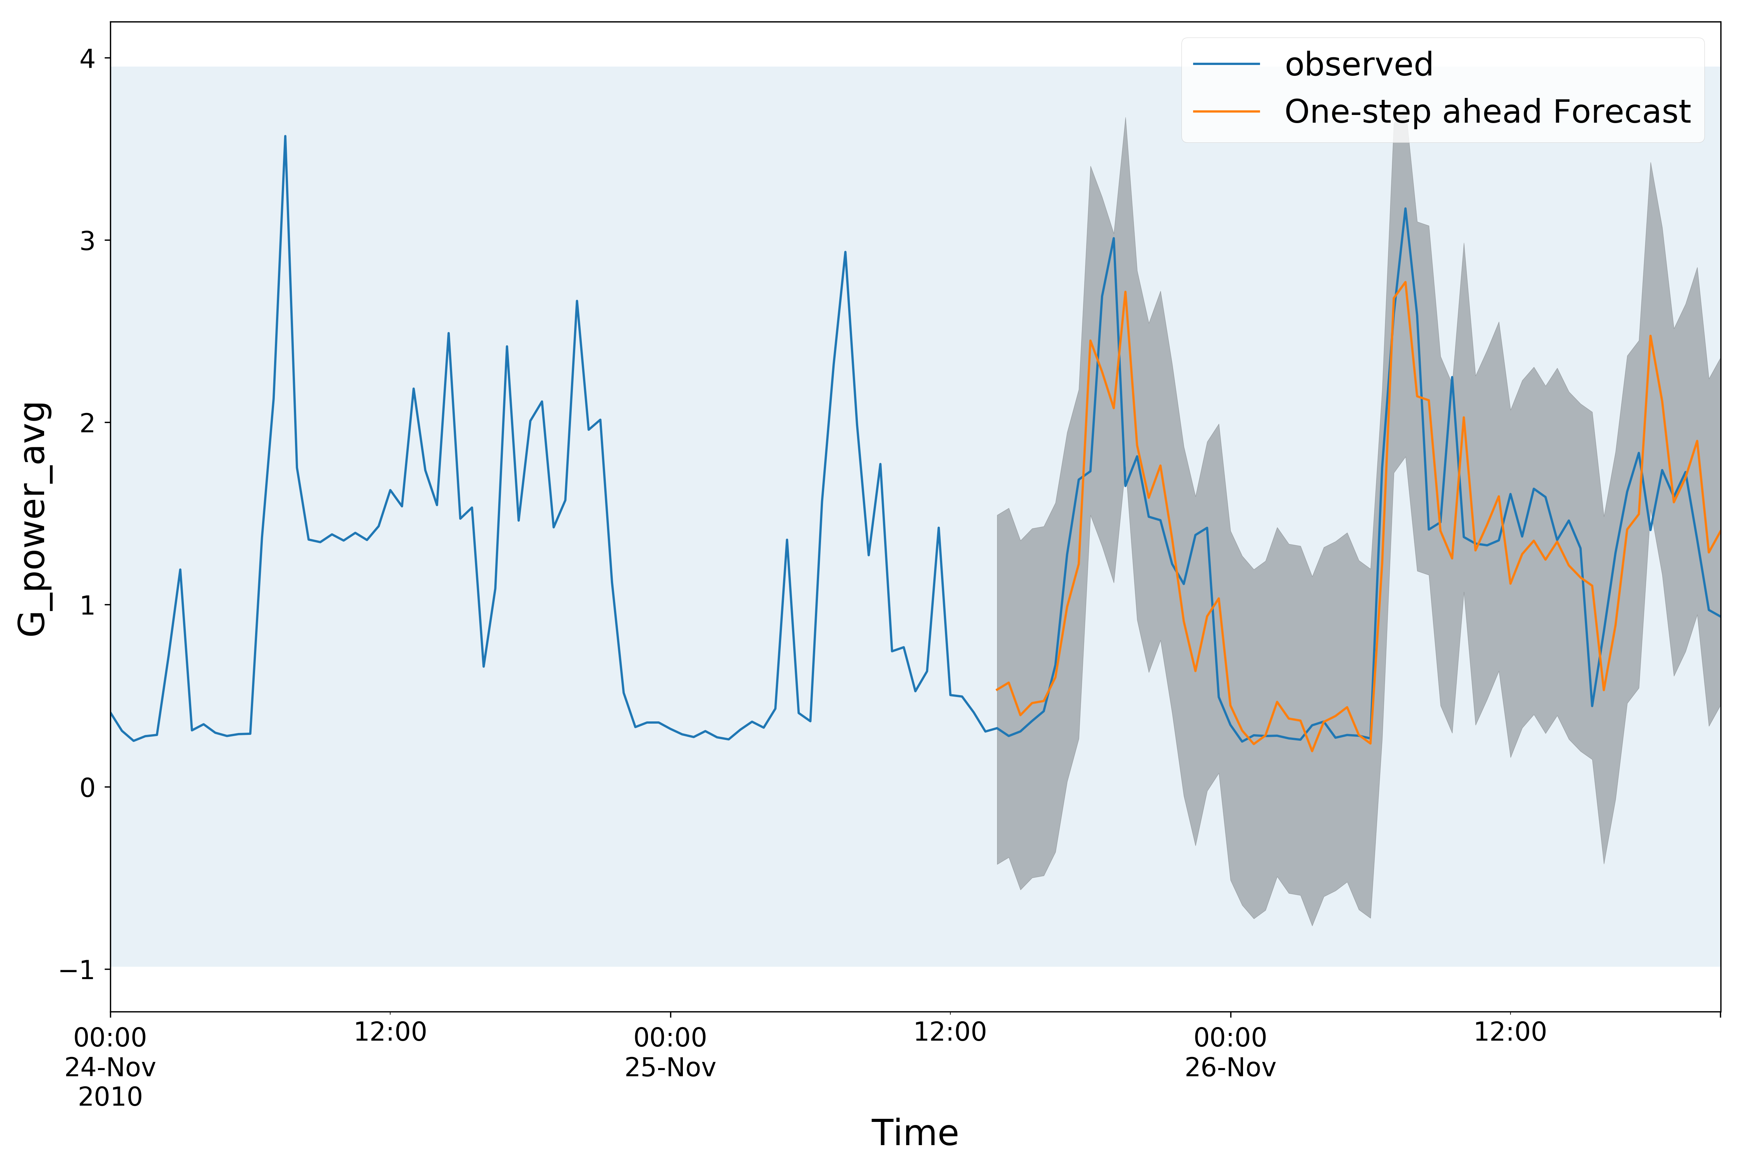
The second part of this lecture will cover reconstruction
based anomaly detection
Multivariate Data
Time Series Data
[1]
[2]
[1]: https://liorpachter.wordpress.com/2014/05/26/what-is-principal-component-analysis/
[2]: https://github.com/Jenniferz28/Time-Series-ARIMA-XGBOOST-RNN

Slide 6
The second part of this lecture will cover reconstruction
based anomaly detection
Multivariate Data
Time Series Data
[1]
[2]
[1]: https://liorpachter.wordpress.com/2014/05/26/what-is-principal-component-analysis/
[2]: https://github.com/Jenniferz28/Time-Series-ARIMA-XGBOOST-RNN

Slide 7
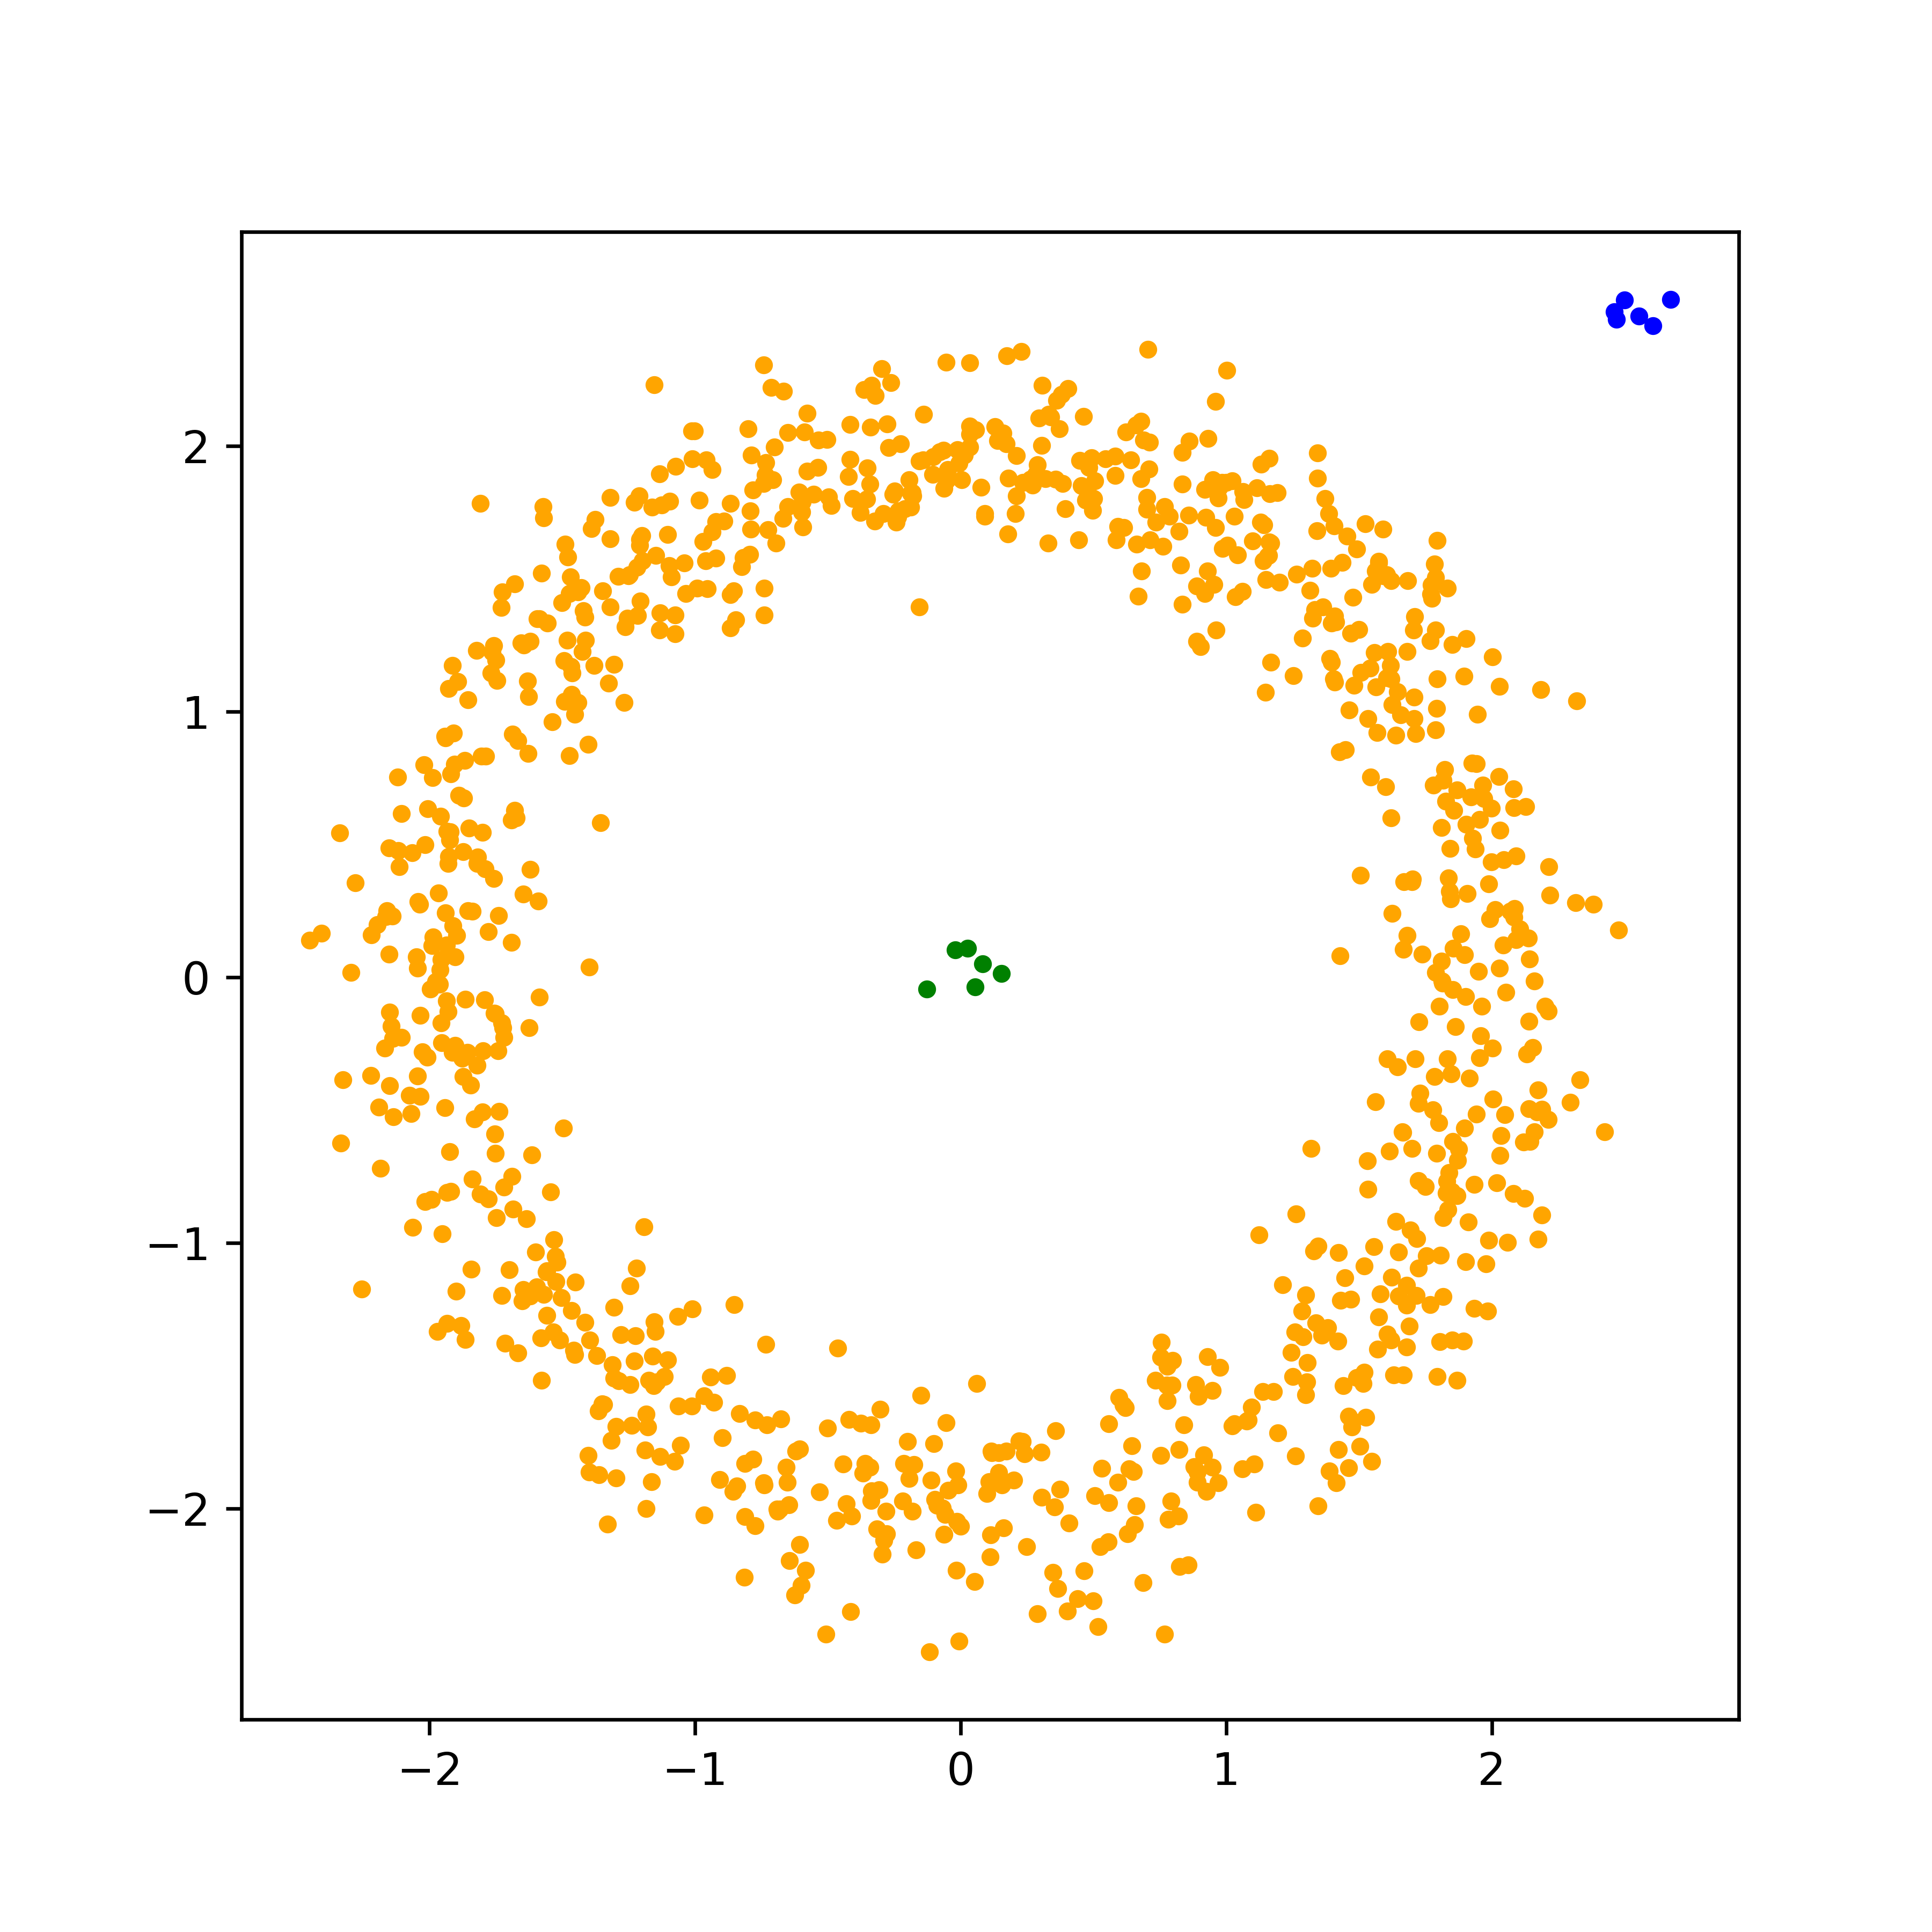
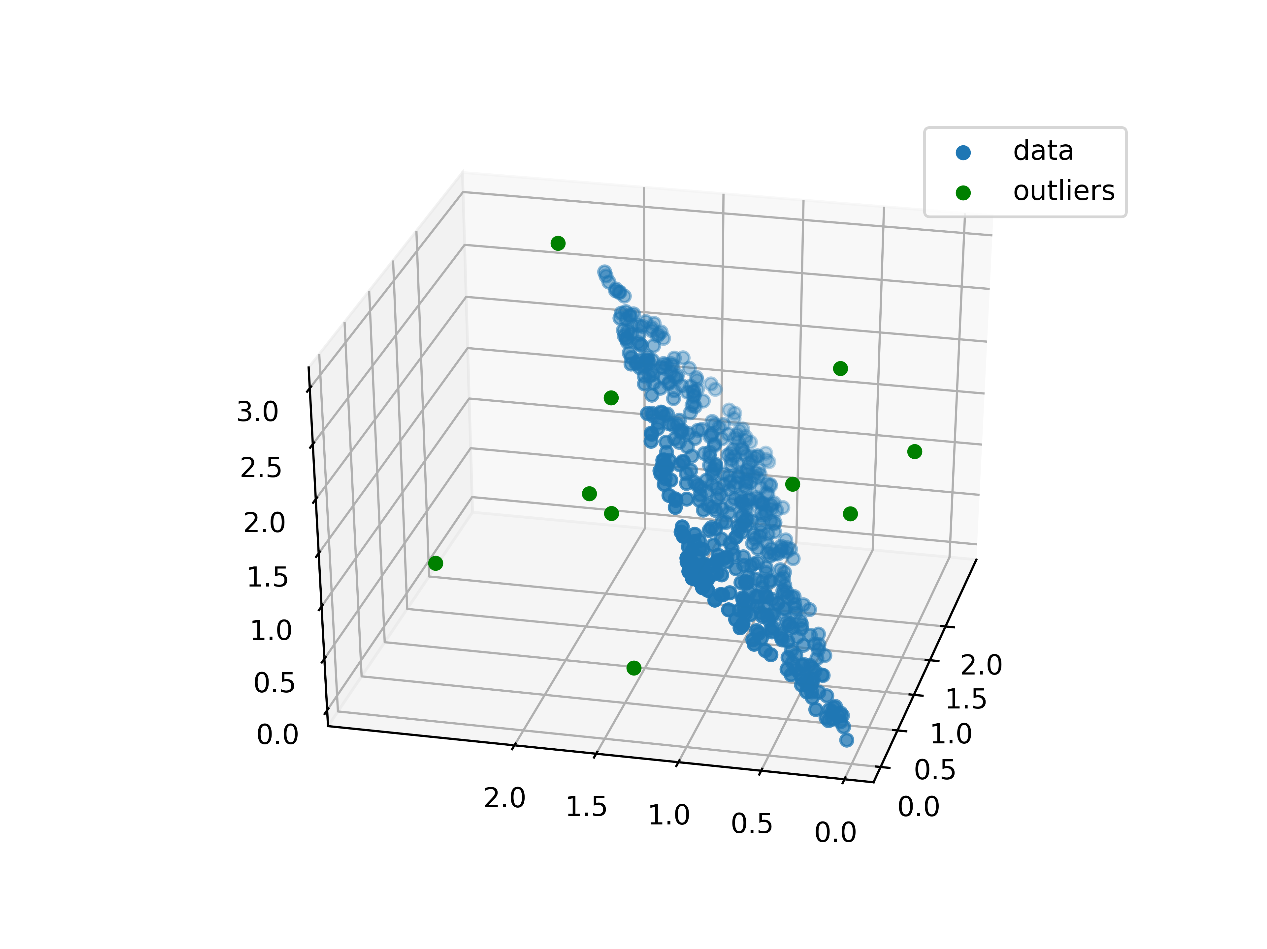
If we can learn a low-dimensional representation of our
data, we can detect outliers that cannot be described in
this fashion

Slide 8
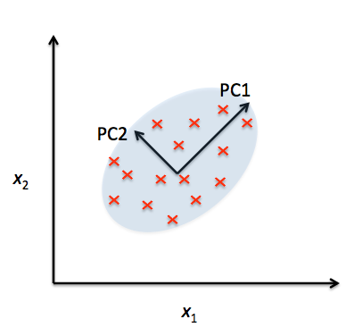
Principal component analysis (PCA)

Slide 9
PCA can be used to describe data that lies in linear
subspaces

Slide 10
PCA will not, however, work (as well) if the data lies on a
nonlinear manifold (e.g. the shell of a sphere)

Slide 11
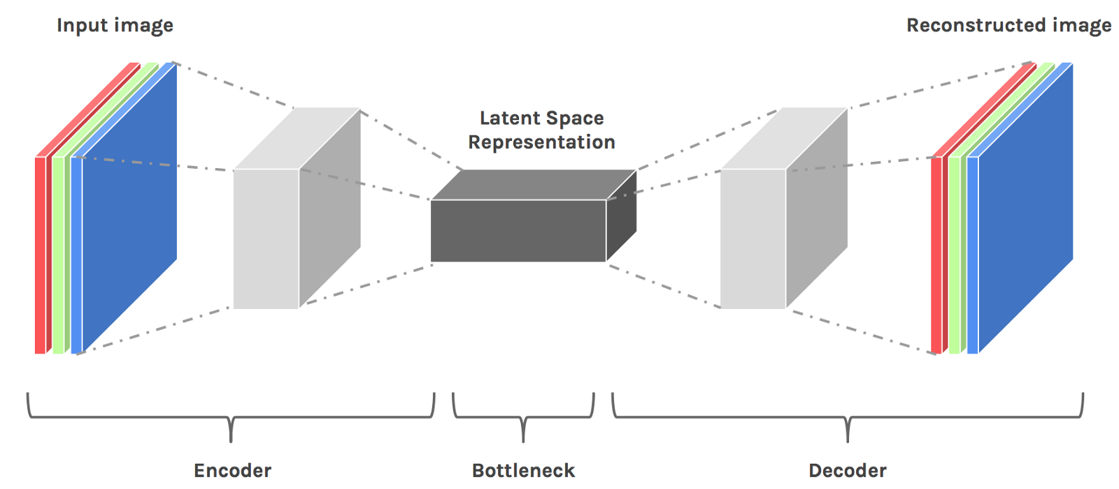
There are other, non-linear, dimensionality reduction
algorithms that can learn these distributions, however,
these often require the tuning of many parameters.
https://hackernoon.com/latent-space-visualization-deep-learning-bits-2-bd09a46920df

Slide 12
The second part of this lecture will cover reconstruction
based anomaly detection
Multivariate Data
Time Series Data
[1]
[2]
[1]: https://liorpachter.wordpress.com/2014/05/26/what-is-principal-component-analysis/
[2]: https://github.com/Jenniferz28/Time-Series-ARIMA-XGBOOST-RNN

Slide 13
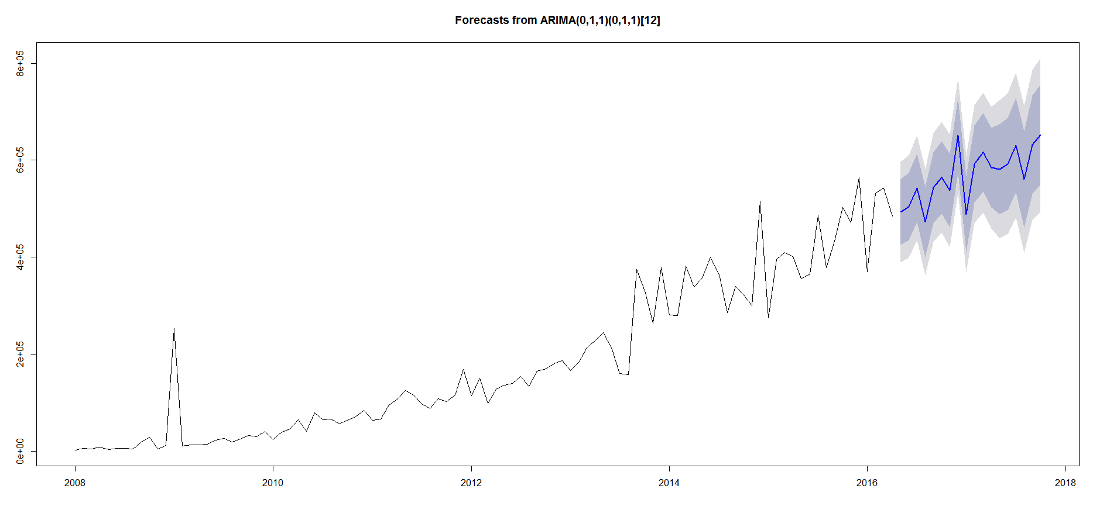
If we have an accurate time-series prediction algorithm,
we can use this to detect outliers
https://stats.stackexchange.com/questions/313851/time-series-forecasting-in-r

Slide 14
If we have an accurate time-series prediction algorithm,
we can use this to detect outliers
If we get a datapoint
out here, it is probably
an outlier
https://stats.stackexchange.com/questions/313851/time-series-forecasting-in-r

Slide 15

One method to perform data forecasting is to use
autoregressive models
$${\hat{x}}_{t}=f\left(x_{t−1}, …, x_{t−n}\right)$$
Value of parameter of
interest at current time step

Slide 16
One method to perform data forecasting is to use
autoregressive models
$${\hat{x}}_{t}=f\left(x_{t−1}, …, x_{t−n}\right)$$
Value of parameter of
interest at current time step
Value of parameter of
interest at previous time
steps

Slide 17
One method to perform data forecasting is to use
autoregressive models
Some function, e.g linear
$${\hat{x}}_{t}=f\left(x_{t−1}, …, x_{t−n}\right)$$
Value of parameter of
interest at current time step
Value of parameter of
interest at previous time
steps

Slide 18

A linear autoregressive model (often just called an
autoregressive model) will therefore look like this
$${\hat{x}}_{t}=f\left(x_{t−1}, …, x_{t−n}\right)=\sum_{i=1}^{n}{a_{i}x_{t−i}}$$

Slide 19

A linear autoregressive model (often just called an
autoregressive model) will therefore look like this
We estimate these using
ordinary least squares
$${\hat{x}}_{t}=f\left(x_{t−1}, …, x_{t−n}\right)=\sum_{i=1}^{n}{a_{i}x_{t−i}}$$

Slide 20
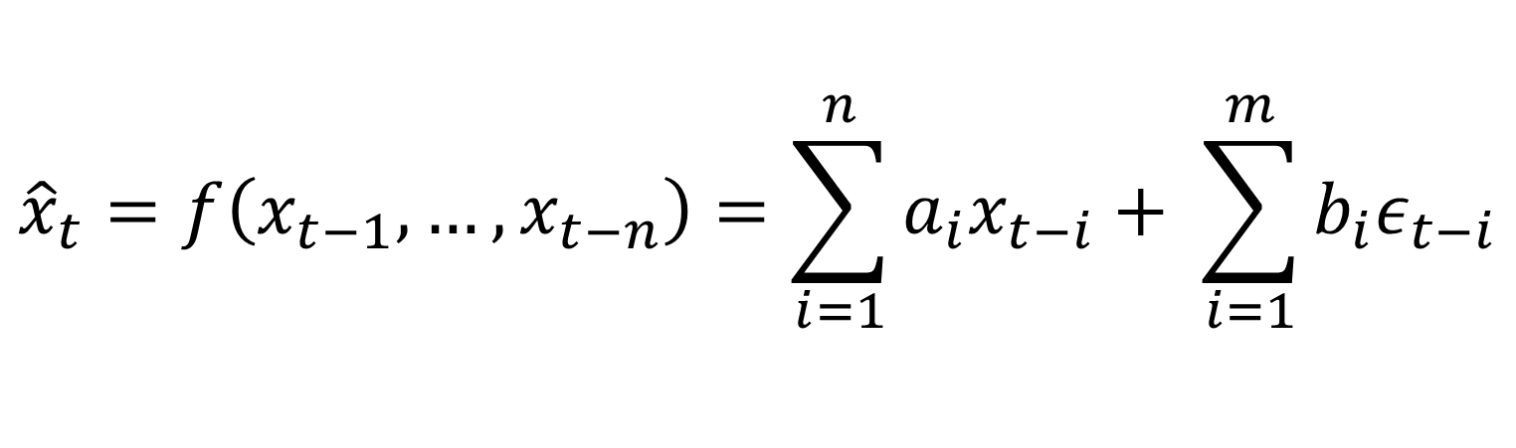
This model is often extended to include previous
prediction errors as well
$${\hat{x}}_{t}=f\left(x_{t−1}, …, x_{t−n}\right)=\sum_{i=1}^{n}{a_{i}x_{t−i}}+ \sum_{i=1}^{m}{{b_{i}ε}_{t−i}}$$

Slide 21
This model is often extended to include previous
prediction errors as well
We estimate these using
ordinary least squares
$${\hat{x}}_{t}=f\left(x_{t−1}, …, x_{t−n}\right)=\sum_{i=1}^{n}{a_{i}x_{t−i}}+ \sum_{i=1}^{m}{{b_{i}ε}_{t−i}}$$

Slide 22

This model is often extended to include previous
prediction errors as well
We estimate these using
ordinary least squares
$$ε_{t−i}=x_{t−i}− {\hat{x}}_{t−i}$$
$${\hat{x}}_{t}=f\left(x_{t−1}, …, x_{t−n}\right)=\sum_{i=1}^{n}{a_{i}x_{t−i}}+ \sum_{i=1}^{m}{{b_{i}ε}_{t−i}}$$

Slide 23
Live coding!

